Slide 1
Ontology
An ontology formally defines a common set of terms that are used to describe and represent a domain
An ontology is domain specific, and it is used to describe and represent an area of knowledge.
It contains terms and the relationships among these terms.
There is another level of relationship expressed by using a special group of terms: properties
These property terms describe various features and attributes of the concepts, and they can also be used to associate different classes together.
ontology encodes the knowledge of the domain in such a way that the knowledge can be understood by a computer. This is the basic idea of ontology.

Slide 2
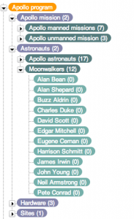
Taxonomy
Taxonomy is the science of classification.
Originally, it referred only to the classifying of organisms.
Now, it is often used in a more general setting, referring to the classification of things or concepts, as well the schemes underlying such a classification.
In addition, taxonomy normally has some hierarchical relationships embedded in its classifications

Slide 3
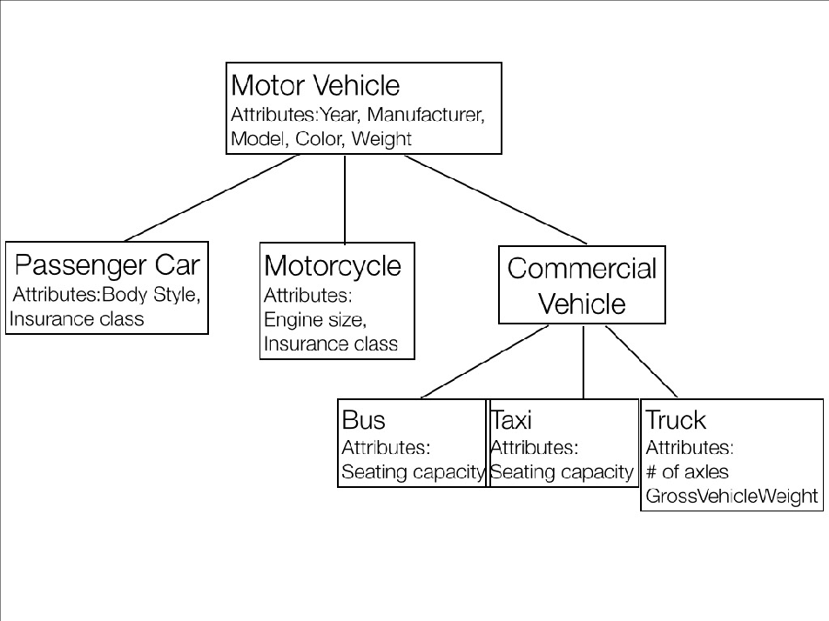
Taxonomy
It allows subjects to be arranged in a hierarchy.
The nodes of a taxonomy represent various types of ‘things’ (so called ‘resources’):
It has been adopted to name trees of
generalization-specialization relation.
"Taxonomy is a subset of ontology.
Ontology = taxonomy + axioms.“
"Ontologies are often equated with taxonomic
hierarchies of classes, class definitions, and the
subsumption relation, but ontologies need not be
limited to these forms."

Slide 4
Thesaurus
Thesaurus can be understood as an extension to taxonomy.
it takes taxonomy as described above, allowing subjects to be arranged in a hierarchy.
It adds the ability to allow other statements be made about the subjects.
It has been adopted to name trees of generalization-specialization relation.
"Ontologies are often equated with taxonomic hierarchies of classes, class definitions, and the subsumption relation, but ontologies need not be limited to these forms."

